Slide 1

Serverless IoT Data Processing with Cloud Application Development
In this phase, we will dive into the process of transforming your innovative design into a practical solution for serverless IoT data processing. We will cover the essential steps required to bring your ideas to life.

Slide 2

Identify the Problem
Understand the challenges faced by your organization or customers when it comes to processing IoT data. Explore the pain points and opportunities for improvement to lay a strong foundation for your solution.

Slide 3
Analyze Data Processing Requirements
1
Data Collection
Design an efficient data collection strategy that ensures accurate and reliable information capture from IoT devices.
Data Storage
2
Select appropriate cloud storage solutions for handling large volumes of IoT data while ensuring data security and scalability.
3
Data Processing
Define data processing pipelines and algorithms that enable real-time or batch processing of IoT data for actionable insights.

Slide 4

Choose the Right Technologies
Explore the wide range of cloud-based tools and services available for serverless IoT data processing. Evaluate their capabilities, compatibility, and cost to make informed technology decisions.

Slide 5

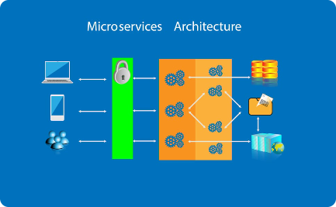
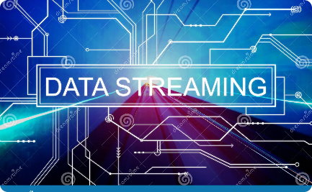
Design Scalable Architecture
Cloud Infrastructure
Microservices Architecture
Data Streaming
Create a scalable and resilient architecture that leverages the power of cloud computing to handle varying workloads and maximize resource utilization.
Utilize efficient data streaming technologies to enable real-time processing and analysis of high-velocity IoT data streams.
Implement a modular and decoupled architecture using microservices to enhance flexibility, maintainability, and scalability of your IoT data processing solution.

Slide 6
Develop and Test
Code Development
Unit Testing
Implement the solution using appropriate programming languages and frameworks that align with the chosen cloud platform.
Validate the functionality and performance of individual components through rigorous unit testing to ensure reliable operation of your IoT data processing solution.
Integration Testing
Performance Testing
Verify the interoperability and compatibility of different system components by conducting comprehensive integration testing.
Assess the scalability and responsiveness of your IoT data processing solution by subjecting it to various load and stress testing scenarios.

Slide 7

Deployment and Monitoring
Prepare your solution for production deployment by setting up monitoring and alerting mechanisms to proactively identify and resolve any issues that may arise. Ensure continuous optimization and efficient resource utilization.

Slide 8

Conclusion
Congratulations on successfully transforming your serverless IoT data processing design into a fully functional cloud application. Your solution is now ready to unlock the true potential of IoT data to drive meaningful insights and business value.

